Slide 1

Object Sorting Industrial Robotic Arm Based on Color using Arduino & Computer Vision

Slide 2
Problem Statement
Manual sorting takes a long time when working with a large number of objects, and efficiency and precision will suffer as a result .
This project is proposed to separate the objects from a set according to their color.
Designing and implementation of synchronized robotic arm, which is used to perform all the basic activities like picking up objects and placing them.

Slide 3
Objectives
Object sorting based on color sensing.
Reduce human effort, labor and cost.
To implement this project in agricultural machineries like rice sorter, beans sorter, peanut sorter etc.
Increase efficiency in industrial product sorting.

Slide 4
Abstract
In today's rapidly evolving industrial landscape, automation plays a pivotal role in enhancing efficiency and productivity. This project aims to develop a robotic arm system capable of sorting products based on their colors. The proposed robotic arm integrates mechanical design, electronics, and software to create a versatile and adaptable solution for color-based sorting tasks.
The mechanical design focuses on creating a robust and agile robotic arm structure, incorporating suitable actuators and grippers to facilitate precise manipulation of objects. Electronics components, including servo motors and microcontrollers, are carefully selected and integrated to provide seamless control over the arm's movements.
Software development encompasses the implementation of motor control algorithms, enabling coordinated motion of the robotic arm's joints. Additionally, computer vision techniques, utilizing libraries like OpenCV, are employed to detect and classify colors of objects in the arm's workspace. Decision-making logic is then applied to determine the appropriate actions for sorting based on the detected colors.
By combining innovative design concepts with advanced technology, this project aims to contribute to the advancement of automation solutions in industrial settings, ultimately enhancing operational efficiency and driving towards a more sustainable future.

Slide 5
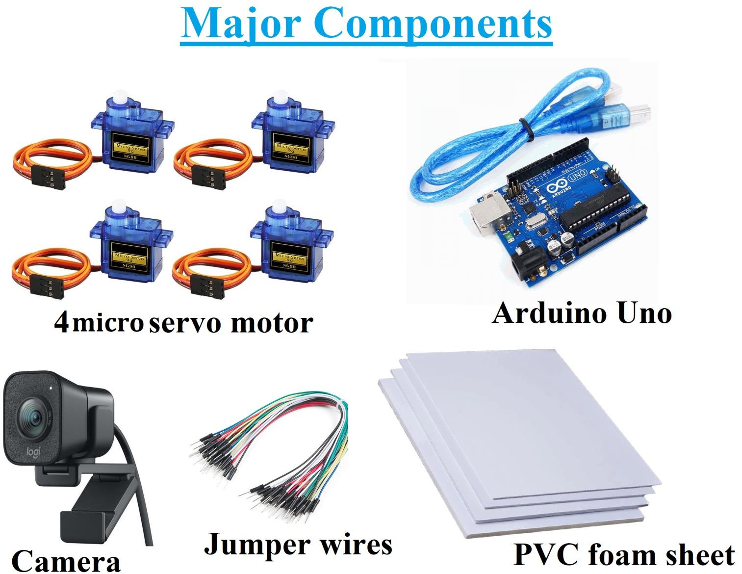

Slide 6
Equipment and Sensor
1.Equipment:
Robotic Arm: A robotic arm capable of precise movements and equipped with actuators such as servo motors or stepper motors.
Arduino Board: An Arduino board serves as the control unit for the robotic arm and interfaces with the sensors and actuators.
Computer: A computer is required to run the OpenCV-based image processing algorithms. It communicates with the Arduino board to control the robotic arm.
LED Lighting System: Proper lighting is crucial for accurate colour detection.
Web Cam: To take live input feed of object and send it to model

Slide 7
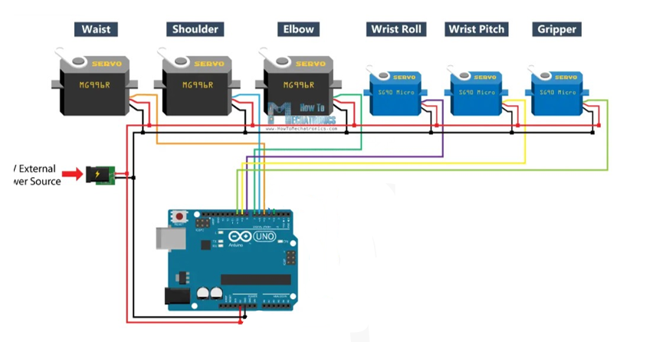
Wire Connection

Slide 8
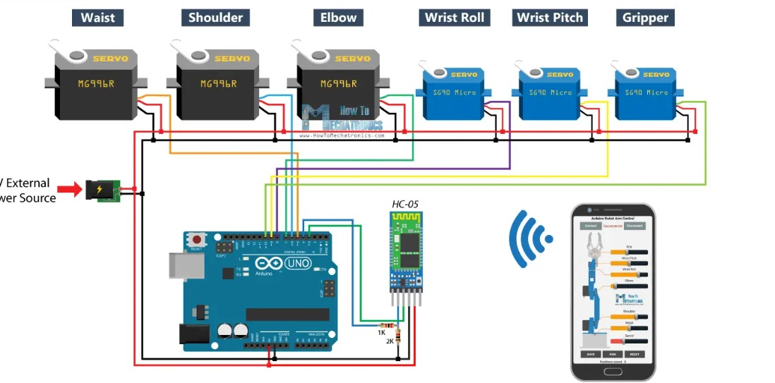





Slide 9
Flowchart
If no object found
Code Initialization
Realtime Camera
Object sensing
Taking
snapshot
Differentiate colors
Object
detection
Initial
position
Put it in the
required box
Take the
object
Calculate
rotation angle of servos

Slide 10
Working Principle
1. Computer Vision:
Color Detection: The code utilizes computer vision techniques to detect and classify colors within the captured video frames. This involves converting the frames to the HSV color space and then applying thresholding to isolate regions of specific colors (red, blue, green) using predefined color ranges.
Contour Detection: After thresholding, contours are detected within the binary masks representing each color. Contours are useful for identifying the shapes and positions of colored objects within the image.
Centroid Calculation: The code calculates the centroid (or center of mass) of the largest contour in each color mask. This centroid is used as a reference point for determining the color label and potentially guiding the robotic arm to interact with objects of that color.

Slide 11
Working Principle
2. Decision Making:
Rule-Based Decision Making: Based on the color detected at the centroid position, the code makes decisions about which action the robotic arm should take. For example, if the centroid corresponds to red, blue, or green regions, the code sends corresponding commands to the Arduino to move the robotic arm to specific positions for picking up objects of those colors.
Conditional Logic: The decision-making process is implemented through conditional statements (if-elif-else) based on the color labels obtained from the computer vision component.

Slide 12
Working Principle
3. Integration with Robotics:
Serial Communication: The code establishes serial communication with an Arduino board to control the robotic arm. This integration allows for the translation of color detection results into physical movements of the arm.
Motor Control: Although not explicitly shown in the provided code snippet, the Arduino code likely involves controlling servo motors attached to the robotic arm's joints. This control enables the arm to move to specific positions for sorting objects based on color.
4. Feedback Loop:
The system likely operates in a feedback loop where the robotic arm picks up objects, brings them to a sorting area, and then releases them based on their color. The computer vision component continuously provides feedback on the colors of the objects being sorted, allowing the system to adapt its actions accordingly.

Slide 13
Program Explanation
Python Script:
Import Libraries: The script starts by importing necessary libraries including OpenCV for image processing and numpy for numerical operations.
Initialize Serial Communication: It initializes serial communication with Arduino using the serial library. The Arduino's COM port and baud rate are specified.
Color Detection Function: The detect_color function takes a frame from the webcam, converts it to the HSV color space, and then applies color thresholds to detect red, blue, and green colors. It then finds contours in the combined mask and determines the color based on the centroid position.
Main Loop: Inside the main loop, it continuously captures frames from the webcam, performs color detection using the detect_color function, and displays the frame with the detected color label. It also sends the color information to the Arduino over serial communication.
Release Resources: Finally, it releases the webcam and closes all OpenCV windows when the loop is terminated.

Slide 14
Program Explanation
Arduino Script:
Include Libraries: The code begins by including the necessary library for controlling servo motors, Servo.h.
Define Servo Objects and Pins: Servo objects are created for each servo motor, and pins are defined to which each servo is connected.
Setup Function: In the setup function, serial communication is initialized, and each servo is attached to its corresponding pin. Additionally, each servo is moved to its initial position.
Loop Function: The loop function continuously checks for available serial data. Upon receiving a color value (R, G, or B) from the Python script, it moves the robotic arm accordingly based on the color detected. Each color corresponds to a specific sequence of servo movements.
Servo Movement Functions: Two functions, moveServoToPosition and returnToInitialPosition, are defined to simplify the servo movement commands. These functions move the servos to specified positions and return them to their initial positions, respectively.

Slide 15
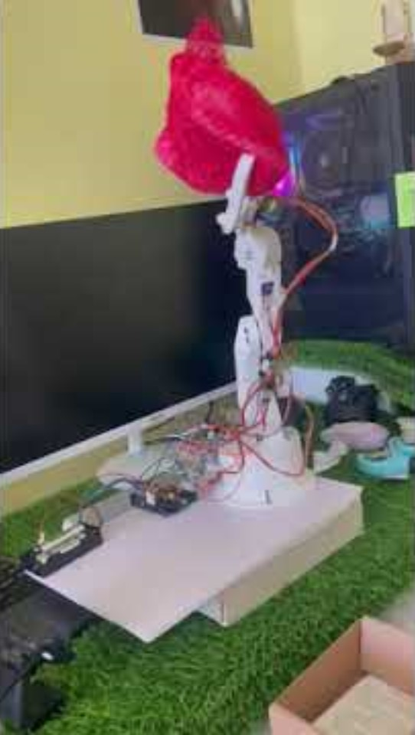
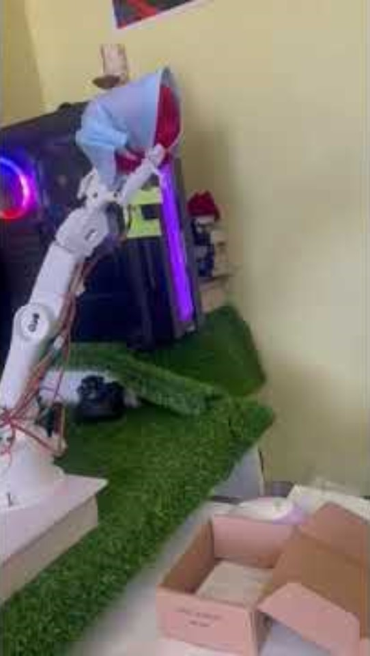
Video

Slide 16
Sorting based on complex colors
Sorting based on size of the objects
Using deep learning techniques to use this robotic hand in agriculture, industries and other fields
Using higher torque stepper motor to lift more weighted objects and moving the arm more precisely
Using a good camera for increasing the precision much more.
Future Improvements

